Slide 1
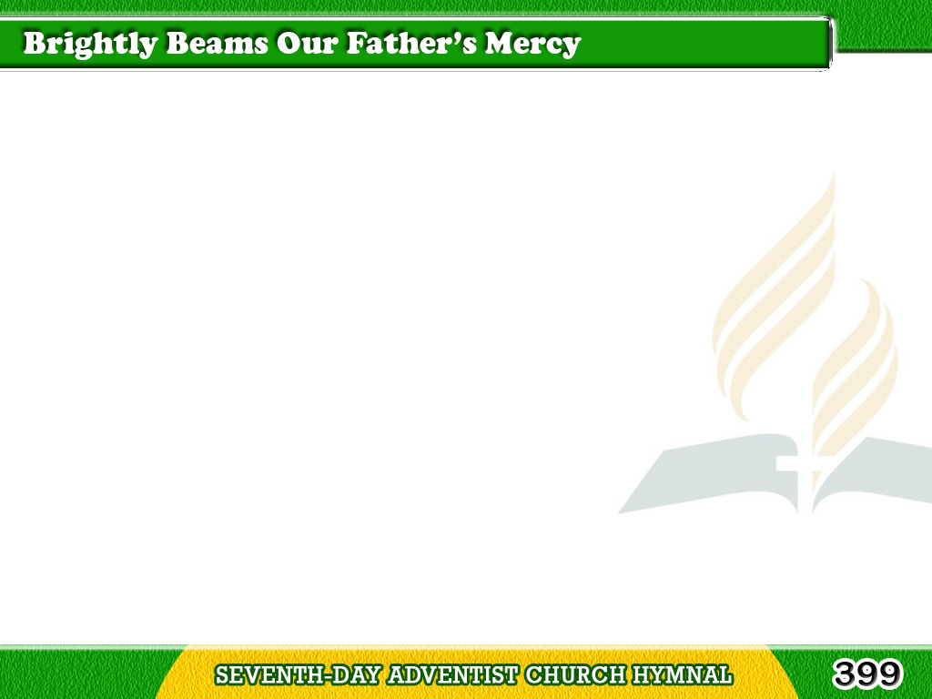
1/3
Brightly beams
our Father’s mercy,
From His lighthouse evermore,
But to us He gives the keeping
Of the lights along the shore.
Tagalog
Version

Slide 2
1/3
Chorus
Let the lower lights be burning!
Send a gleam across the wave!
Some poor fainting,
struggling seaman
You may rescue, you may save.
Tagalog
Version

Slide 3
2/3
Dark the night of sin has settled,
Loud the angry billows roar;
Eager eyes are watching, longing,
For the lights along the shore.
Tagalog
Version

Slide 4
2/3
Chorus
Let the lower lights be burning!
Send a gleam across the wave!
Some poor fainting,
struggling seaman
You may rescue, you may save.
Tagalog
Version

Slide 5
3/3
Trim your feeble lamp,
my brother:
Some poor sailor, tempest tossed,
Trying now to make the harbor,
In the darkness may be lost.
Tagalog
Version

Slide 6
3/3
Chorus
Let the lower lights be burning!
Send a gleam across the wave!
Some poor fainting,
struggling seaman
You may rescue, you may save.
Tagalog
Version

